Slide 1
Business Location Optimization
Adam Davis
June 1, 2020

Slide 2
“There are three things that matter in property: location, location, location.”
--Lord Harold Samuel, British real estate tycoon.

Slide 3
Businesses succeed or fail based on their location.
This project will attempt to find an optimum business location based on the presence of beneficial current businesses (traffic drivers) and existing competitors.
This type of analysis would be of interest to any entrepreneur interested in starting a business or real estate owner trying to establish the value of their property.
Specifically we will search for a good neighborhood for a nighttime live music venue. To be successful, the location should have a sufficiently robust nightlife to support another nighttime business, but not too many nighttime entertainment competitors.
We will use the city of Baltimore in the state of Maryland, USA as our city.

Slide 4
Data Sources
We use the official border of the city of Baltimore, published by the city government.
For businesses driving nighttime traffic to a neighborhood, we will use Foursquare venues in the Food category, which includes numerous types of restaurants.
We consider possible nighttime competitors to be businesses in the following Foursquare categories:
Music Venue
Amphitheater
Circus
Comedy Club
Concert Hall
Country Dance Club
Music Venue (jazz/piano bar/rock club),
Performing Arts Venue
Nightclub
Other Nightlife
Strip Club

Slide 5
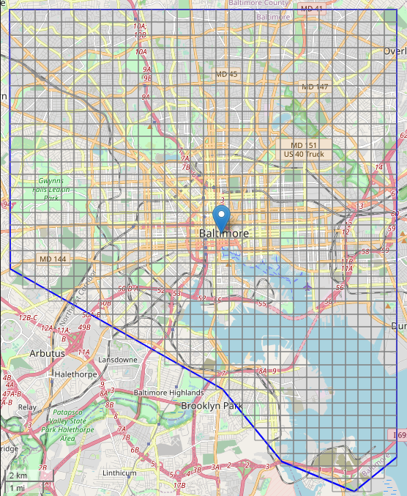
Methodology: Geography
To limit searches to the city boundaries, we divide Baltimore city into 901 squares approximately 500m x 500m. The corners form bounding boxes that we use as inputs to the API Foursquare.
Use Foursquare’s intent=browse and appropriate category filters to return all venues within the bounding box.
Save 1539 traffic drivers and 234 competitors in separate datasets (panda.dataframes)
Calculate any distances needed with latitudes and longitudes using Haversine formula.

Slide 6
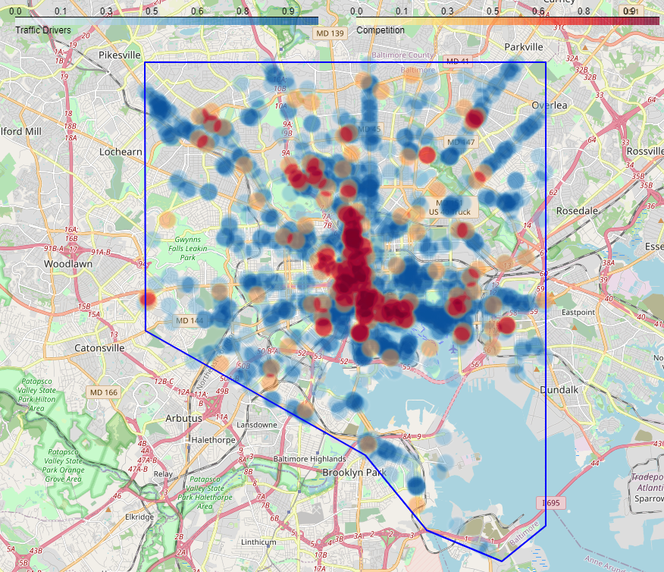
Heatmap of traffic drivers and competitors

Slide 7
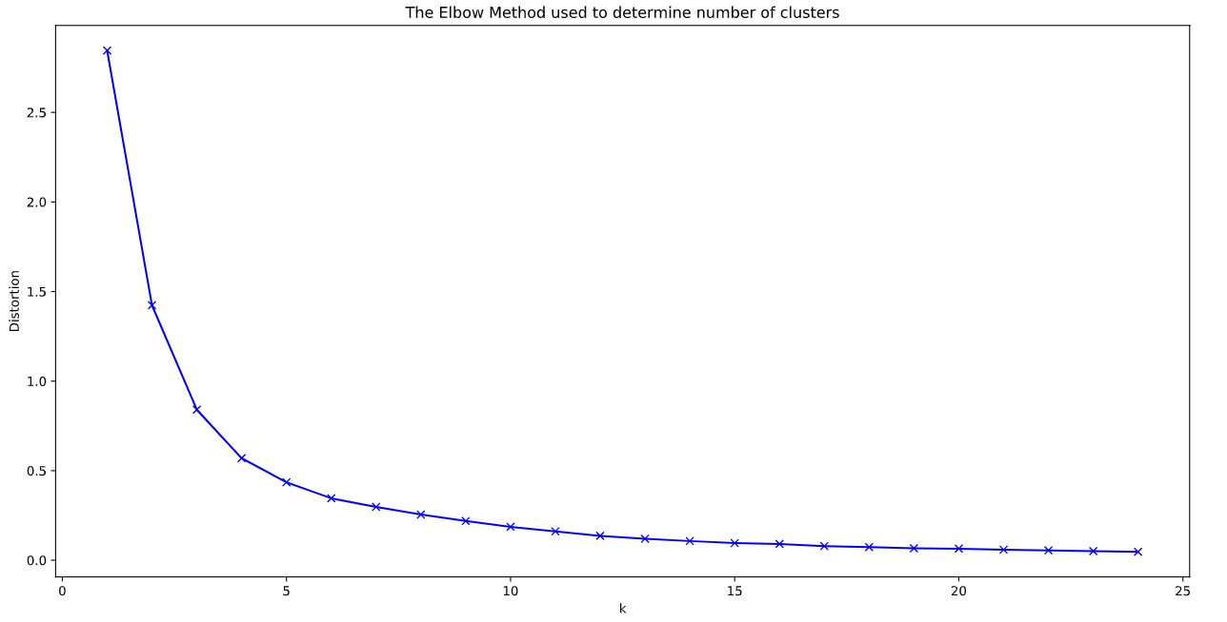
Find number of clusters
Using the elbow method, we find 6 clusters of traffic driving venues.

Slide 8
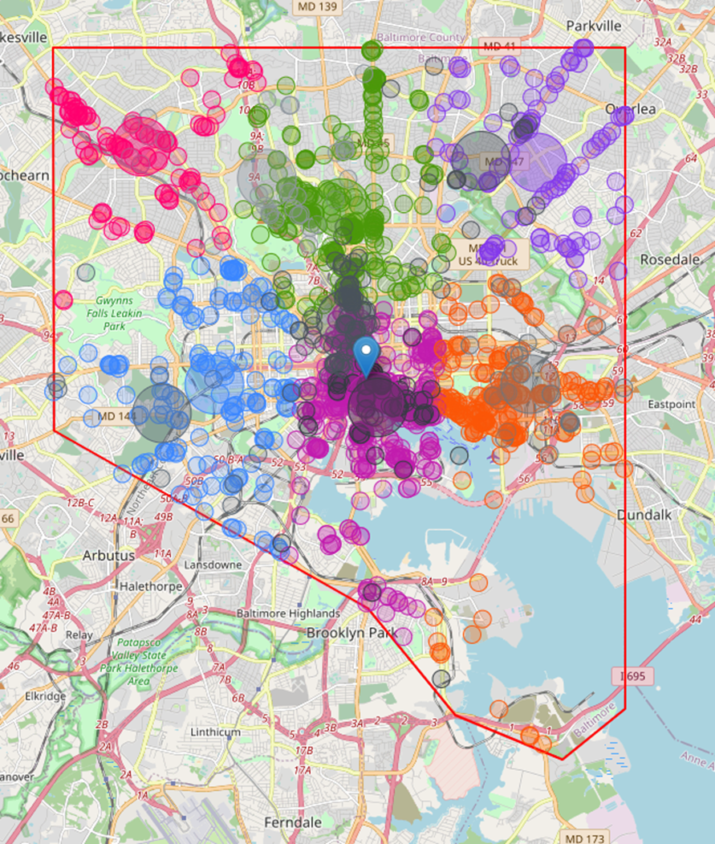
Methodology: Clustering
Traffic driving clusters are color coded.
Competitors are drawn in grey.
Centroids are larger circles.
Unsatisfying!

Slide 9
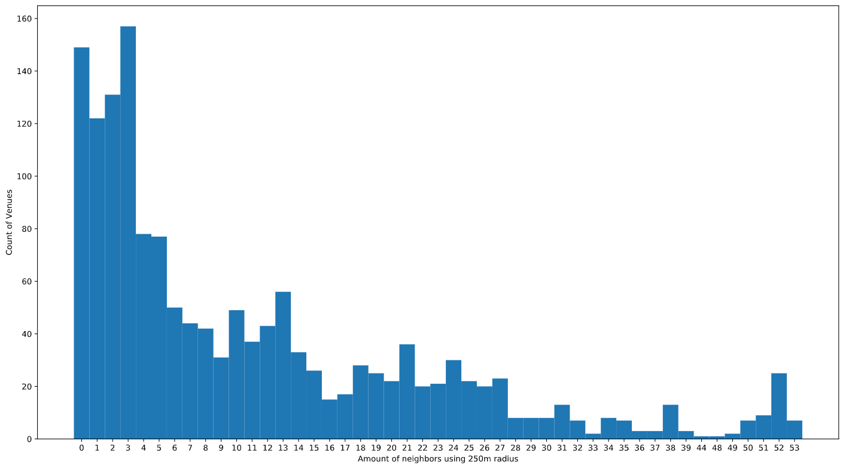
Methodology: Data Cleansing
Venues with few neighbors in a 250m radius are not going to be part of nightlife centers and are only adding noise
Remove venues with only 0-5 neighbors, 46%.
Of the original 1,539 venues, 714 remain.

Slide 10
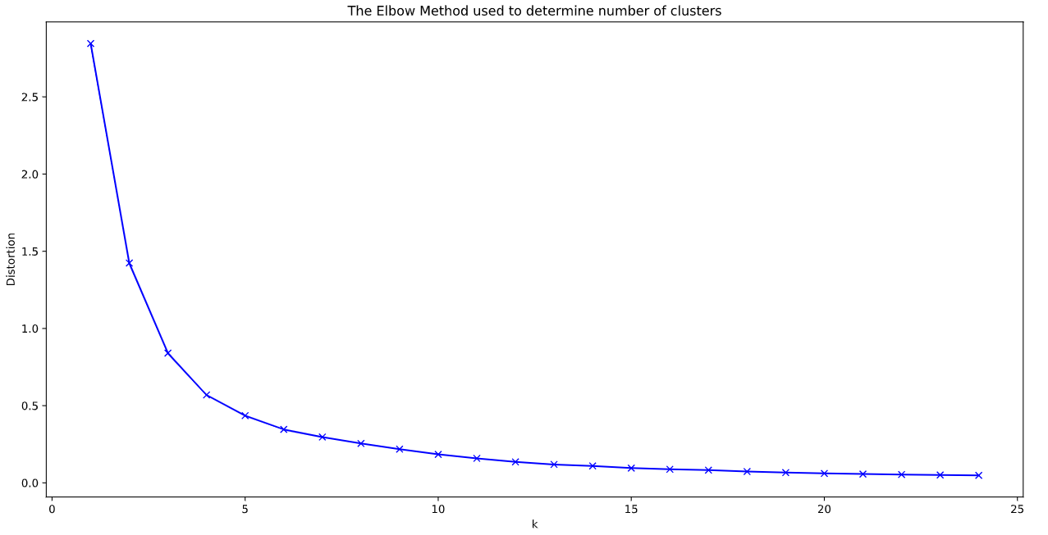
Find number of clusters (2)
With reduced number of venues, calculate number of k-means clusters again.
Again we find 6 clusters of traffic driving venues.

Slide 11
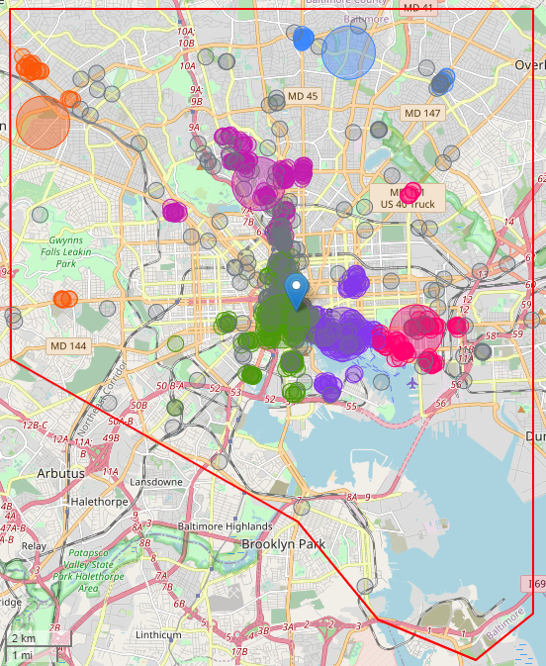
k-means Clusters With Reduced Noise
Highlighted anomalies are disturbing
Several clusters seem like they have small subclusters.
Several centroid centers (larger circles) don’t seem to fall in any kind of nightlife center.
Ex: Orange and blue centers are completely divorced from colored venue centers, and really only indicate the average location.

Slide 12
k-means vs. HDBSCAN
k-means is requires unweighted data, but our lat/long data is nonlinear at 49° latitude.
HDBSCAN doesn’t require a cluster number, only minimum cluster membership
HDBSCAN identifies core members of a cluster
HDBSCAN identifies noise—points that aren’t member of any cluster
HDBSCAN supports Haversine formula for distance calculation

Slide 13
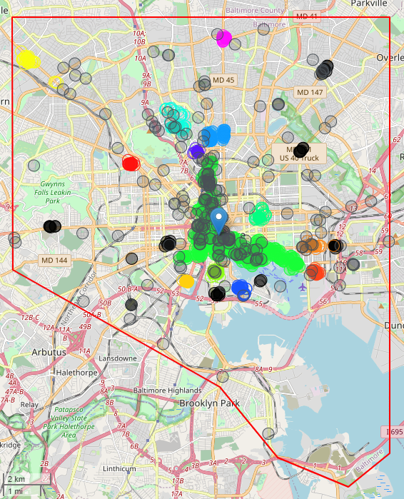
HDBSCAN is a better solution
HDBMEANS clusters with minimum cluster membership of 10 venues.
HDBMEANS finds 12 clusters tightly centered.
HDBMEANS identifies noise (black circles)
Much more satisfying!

Slide 14
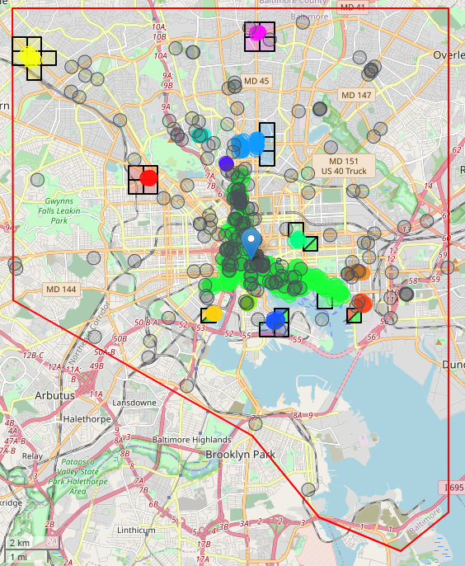
Find squares with low competition
Identify 500m x 500m squares < .5km to traffic driving colored clusters, and with less than 2 competitors in 1km (grey circles).
25 locations (black squares) identified as highly viable and would benefit from further investigation.
4 of the identified locations straddle two nightlife clusters and are thus potentially more valuable

Slide 15
Conclusion
We were able to find promising real estate near traffic driving clusters with reduced competition.
Data inspection reveals there is likely additional noise in both traffic drivers and competitors:
Traffic driver data flaws included private, daytime only, or miscategorized venues that will not build nighttime traffic numbers.
Competitor data included daytime and private businesses that might not be valid competition for our client.
This additional cleaning could be done in later phases.
Further research could be done to establish maximum music venues that might flourish in a neighborhood based on city demographics such as income, age, and population.
HDBSCAN was the best clustering technique for data using latitude and longitude locales, required only a single parameter for use, and assisted in finding noisy points.

